Slide 1
Camera calibration
Cal tech toolbox
Iphone XS Max Camera

Slide 2
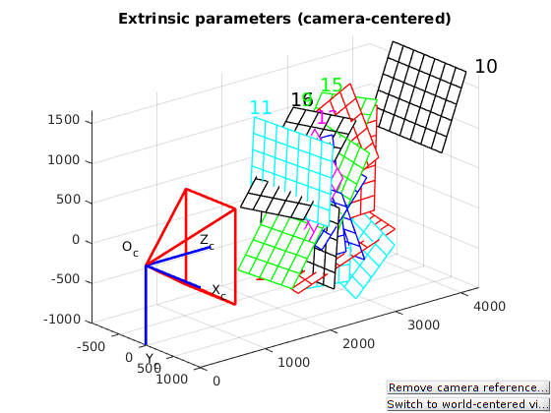

Slide 3
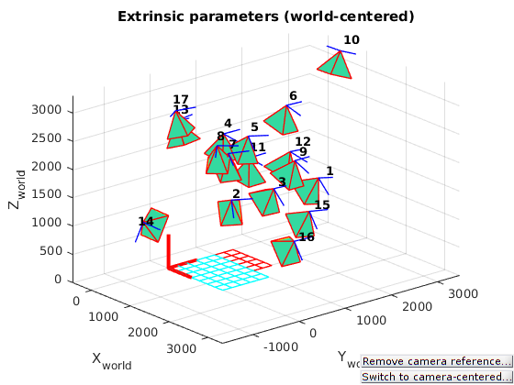

Slide 4
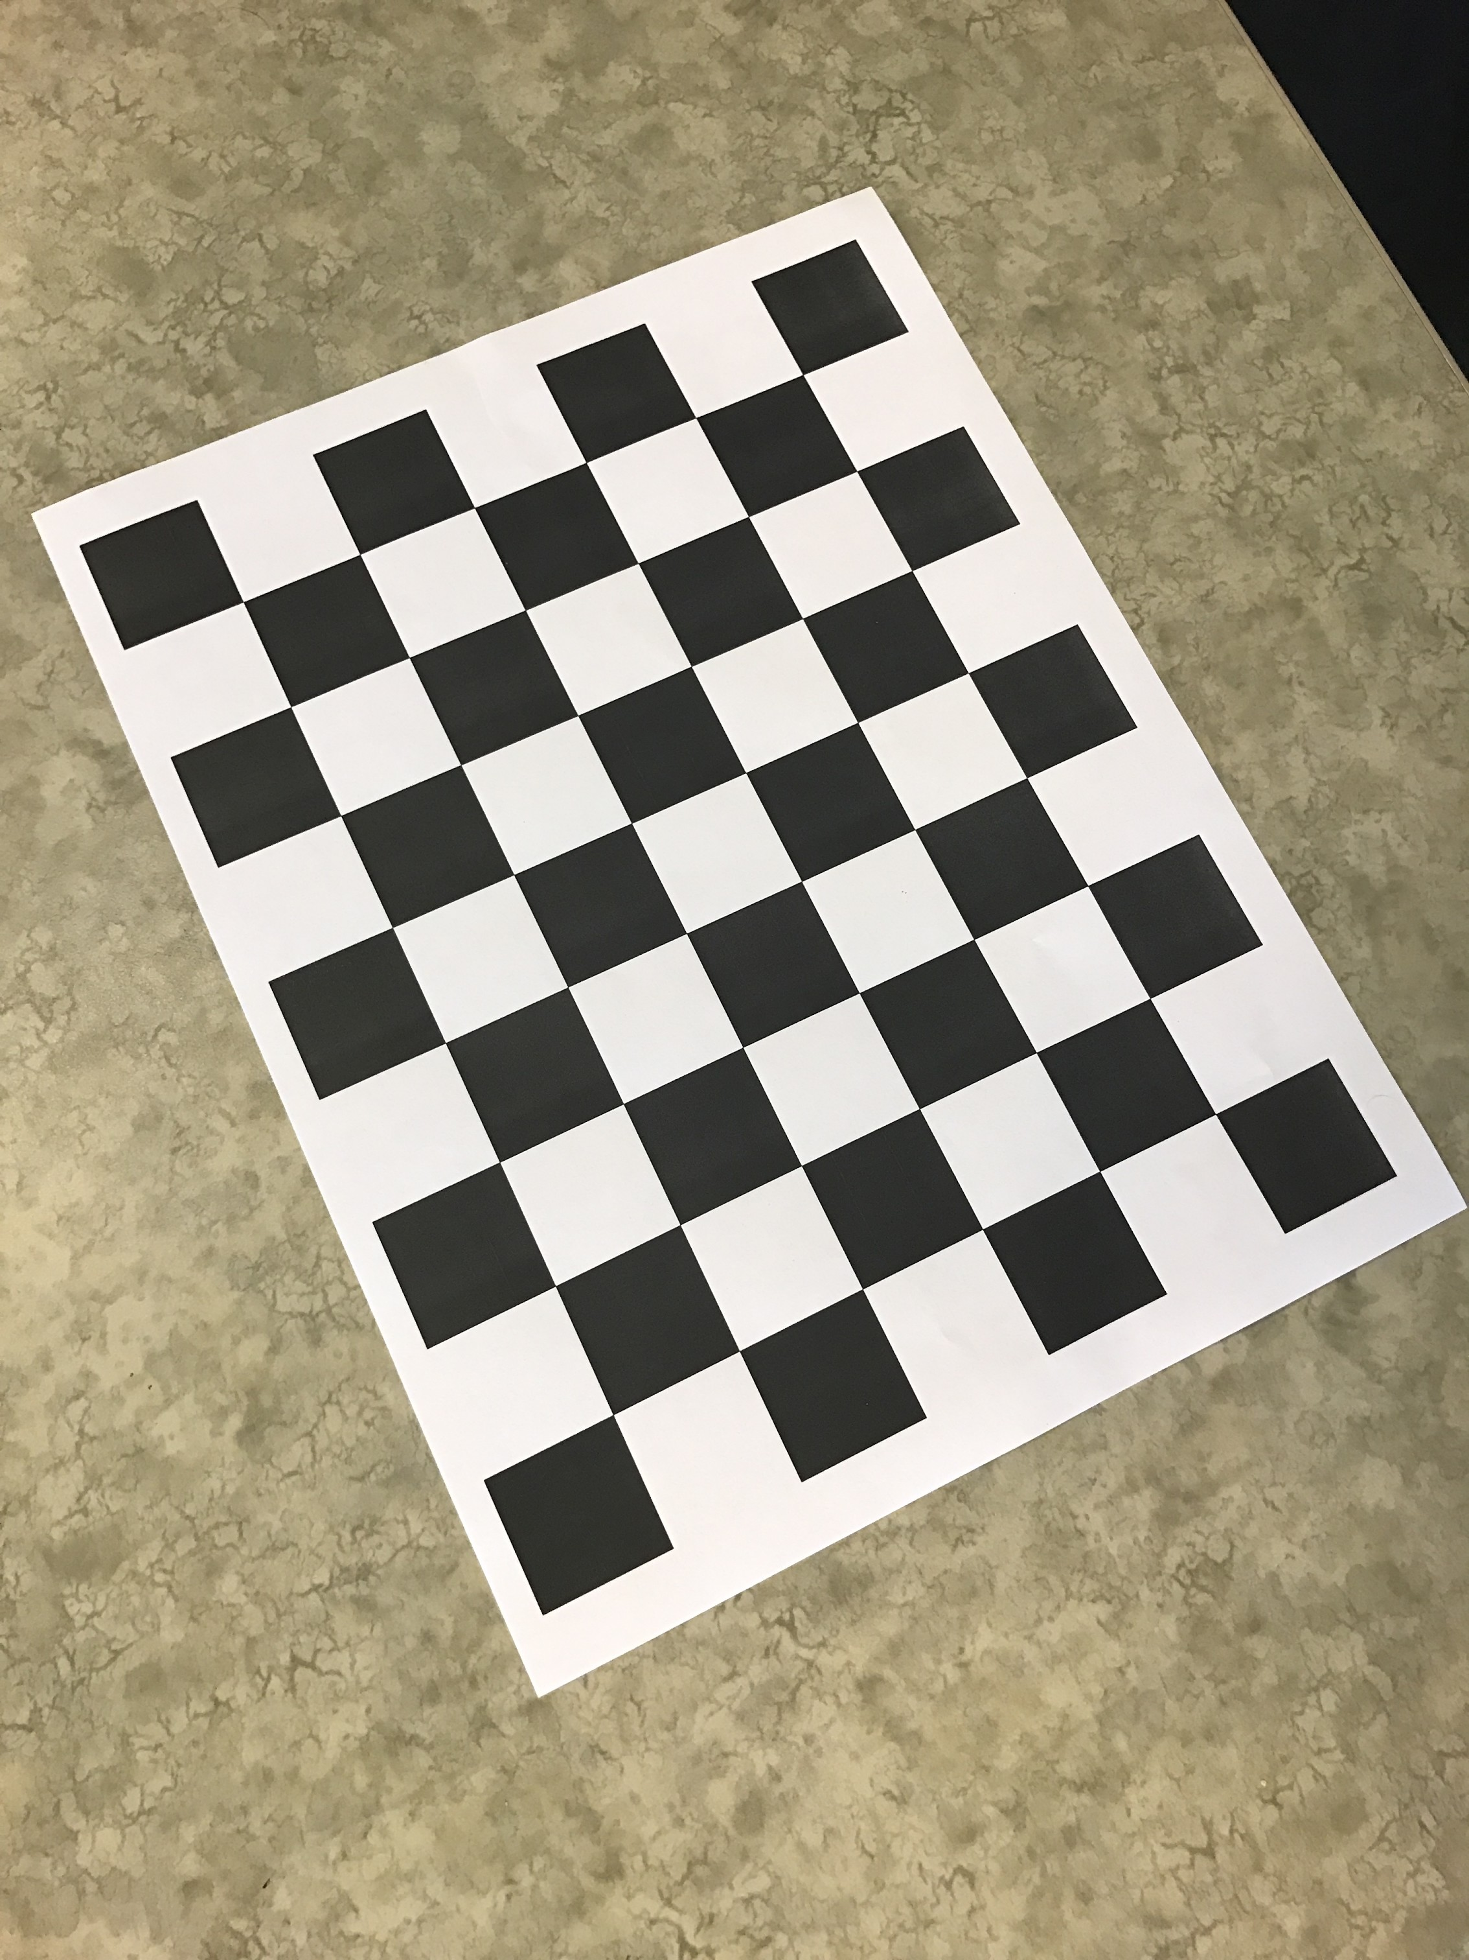

Slide 5
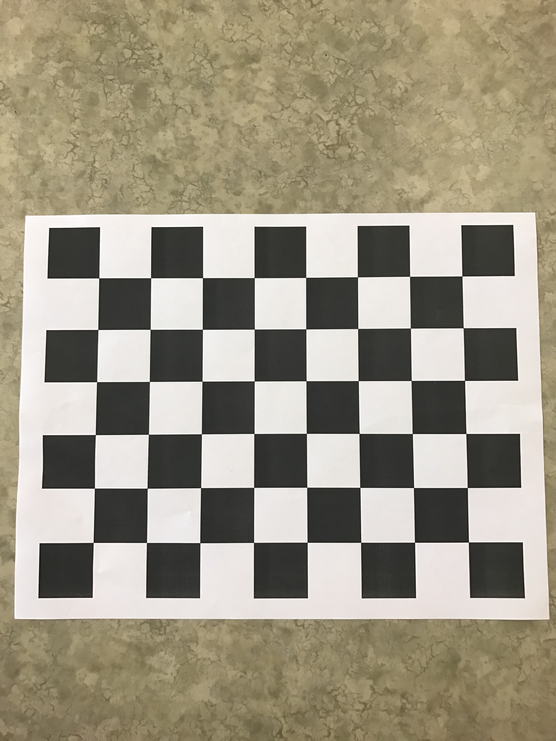

Slide 6
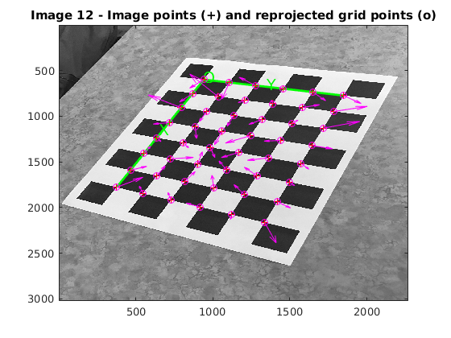

Slide 7
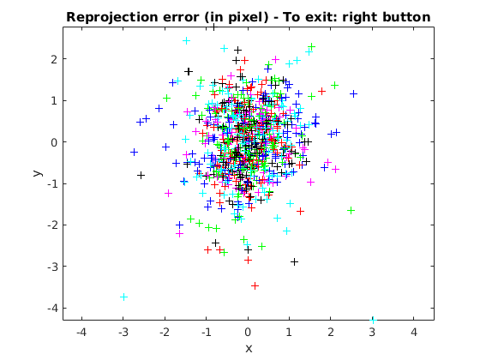

Slide 8
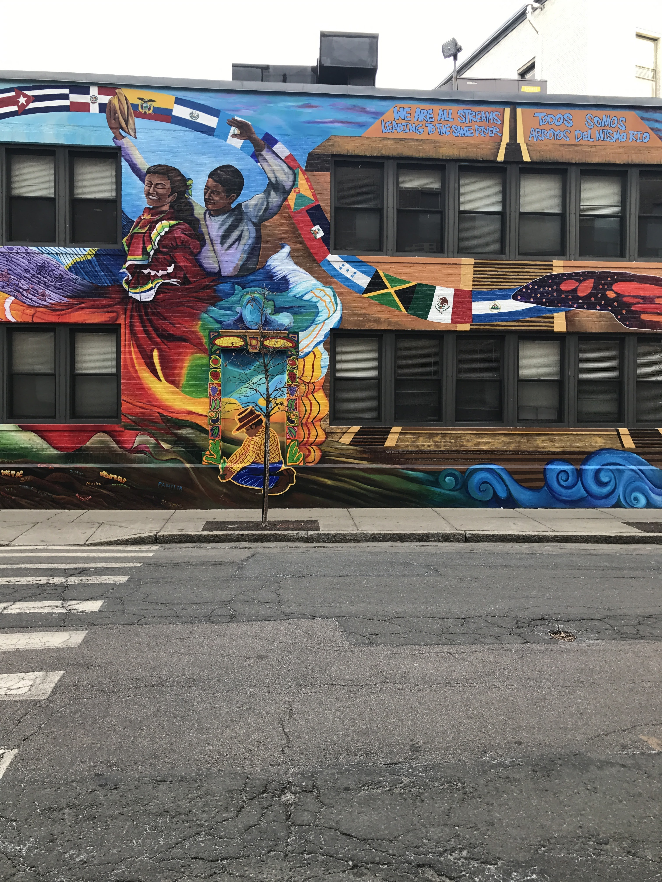
Latino mural center graffiti

Slide 9
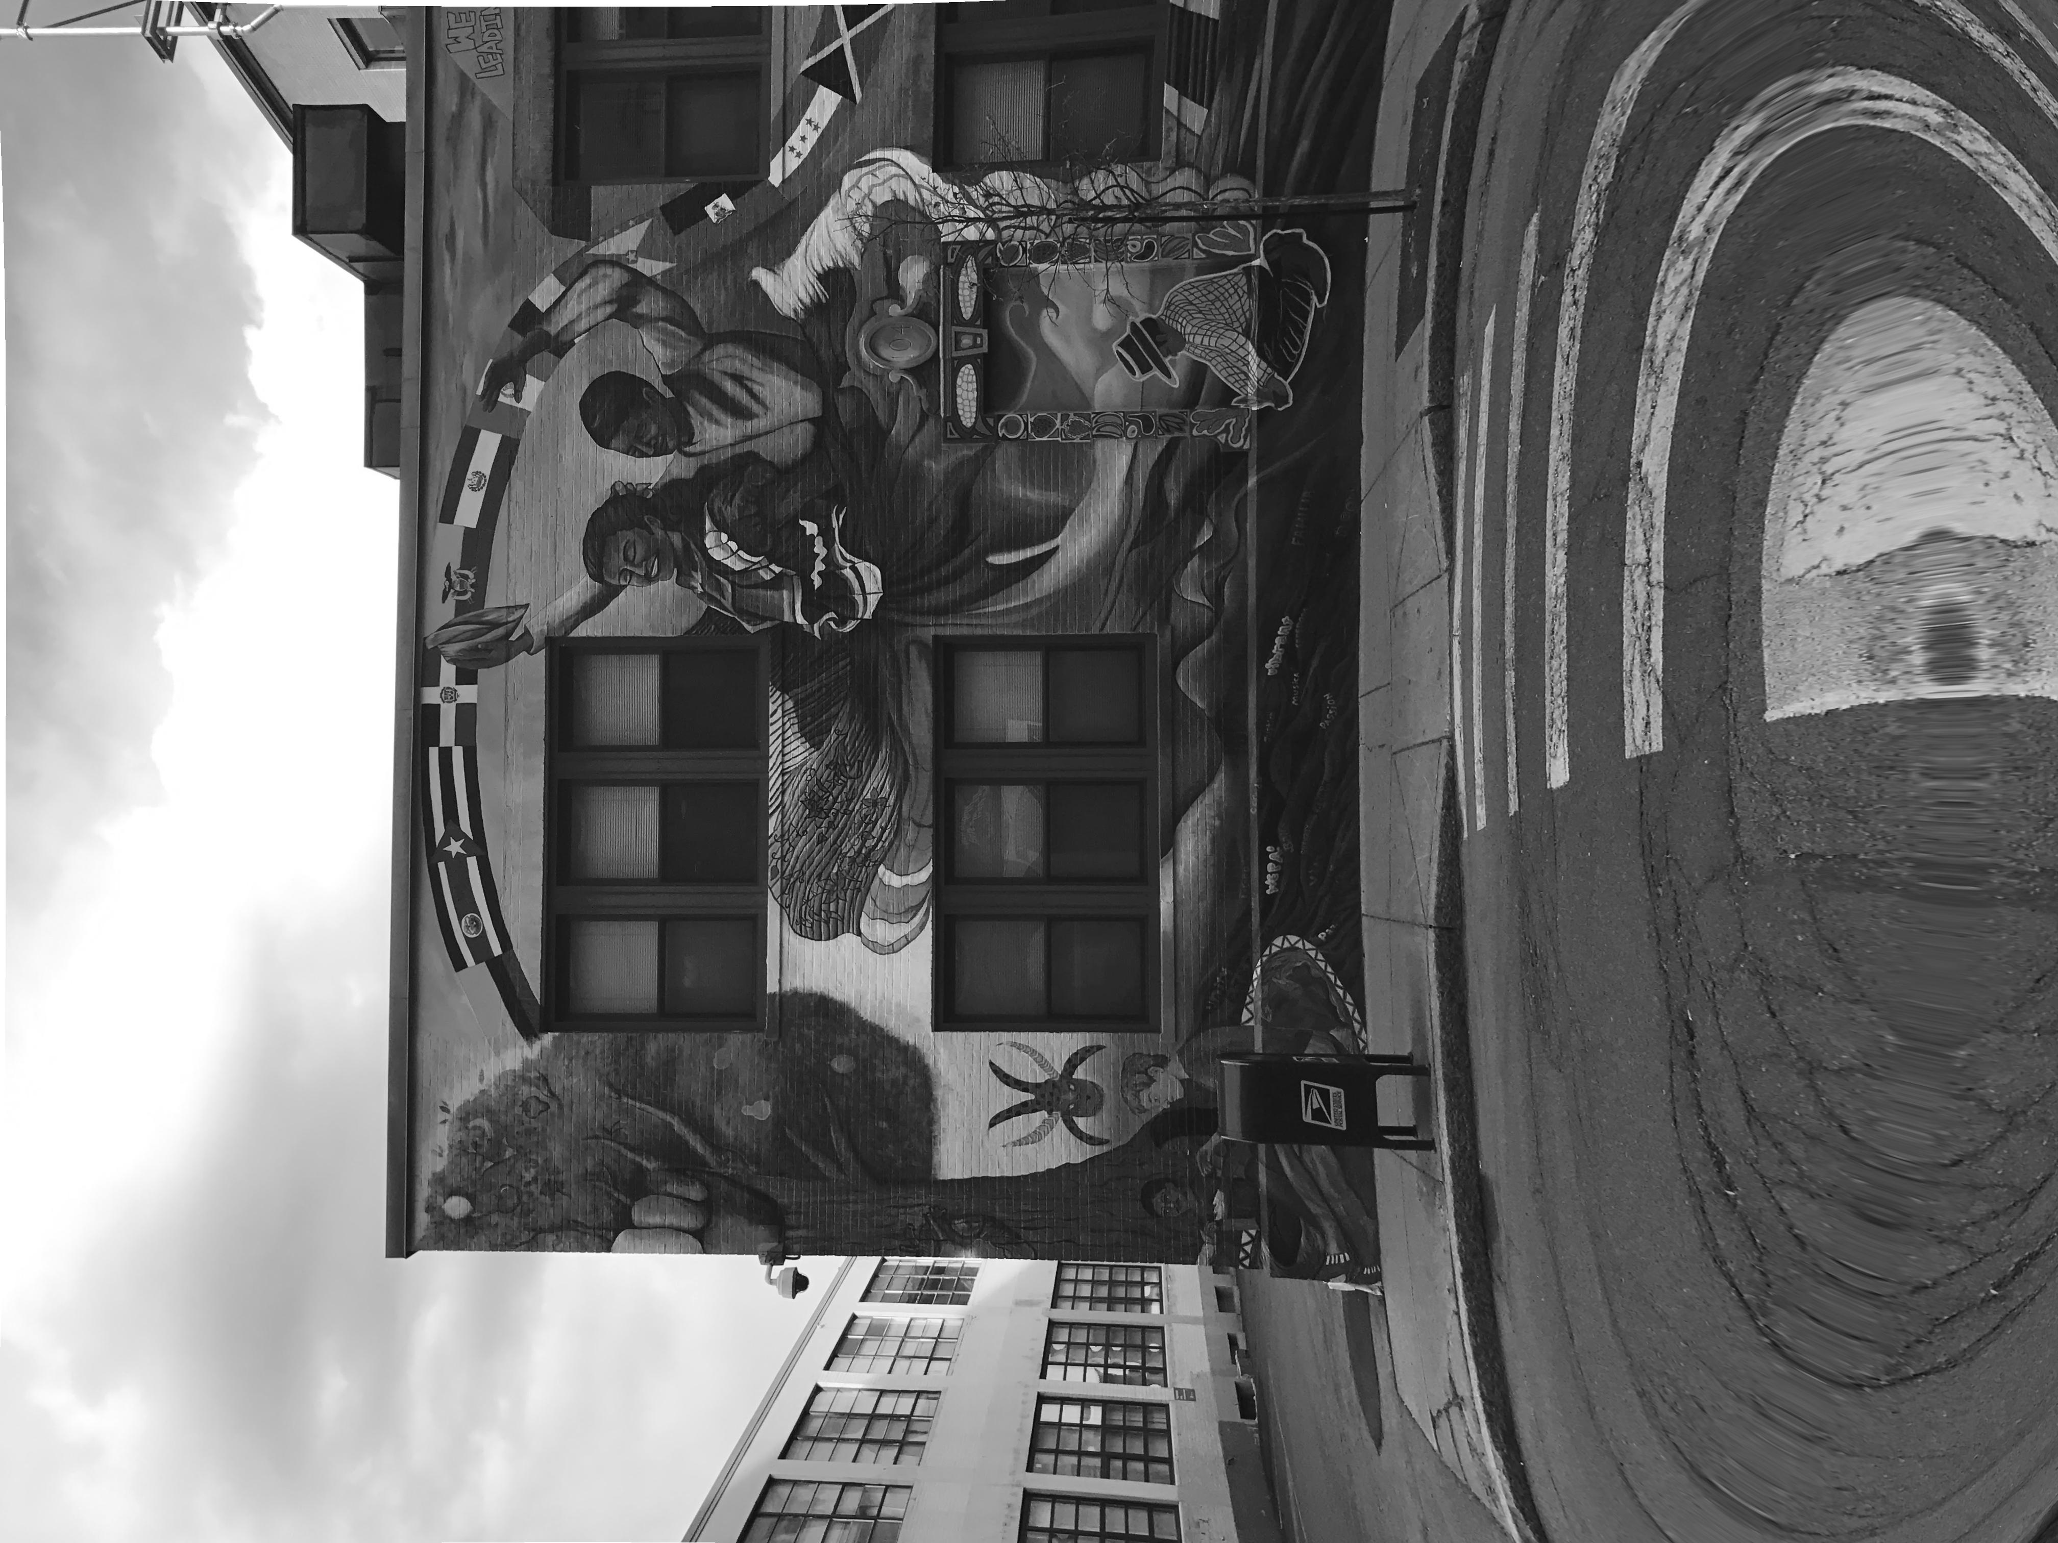

Slide 10
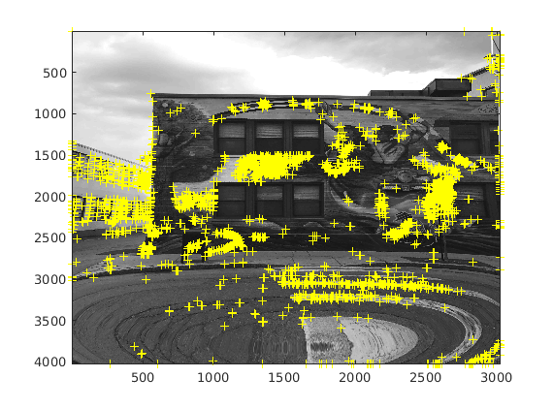

Slide 11
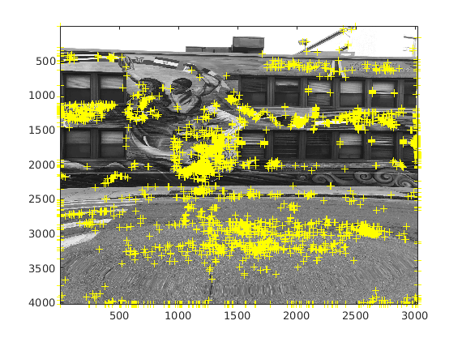

Slide 12
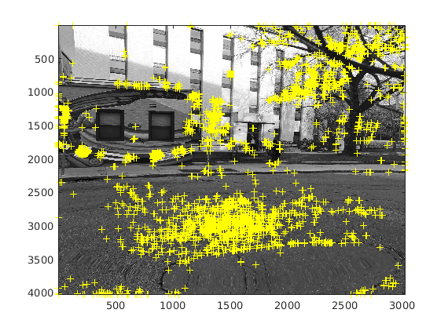

Slide 13
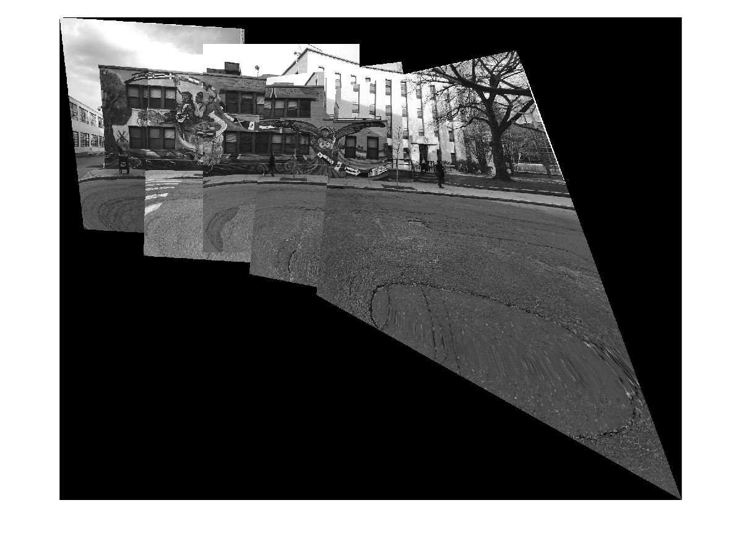
Panaroma

Slide 14
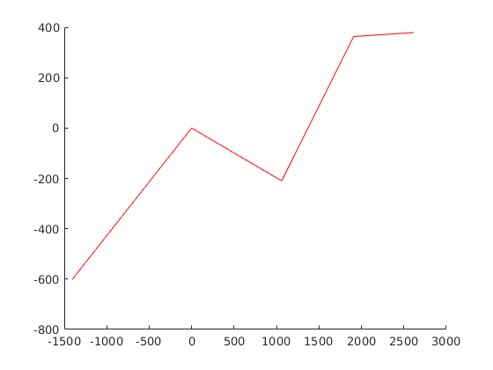
Camera position

Slide 15
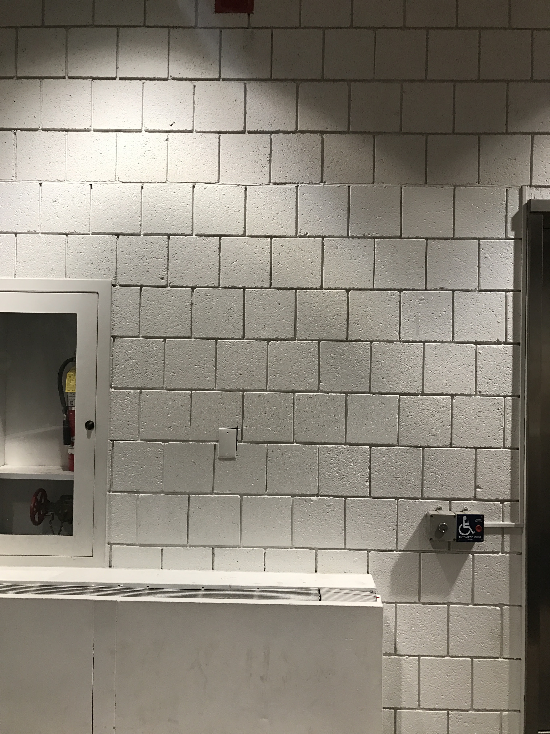
Cinder blocks

Slide 16
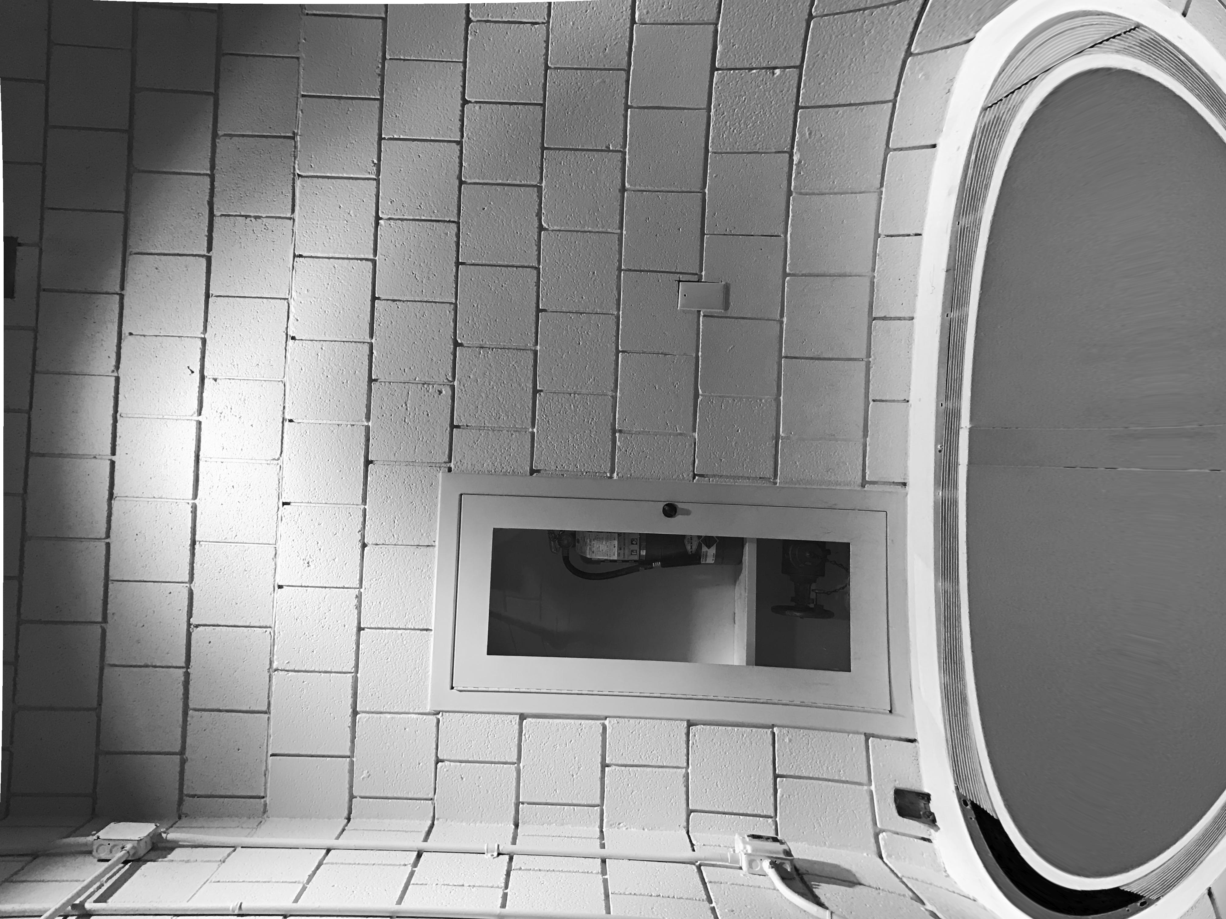
distorted

Slide 17
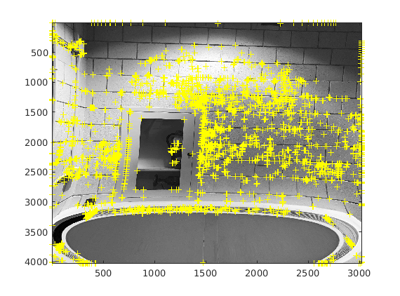
Harris corners

Slide 18
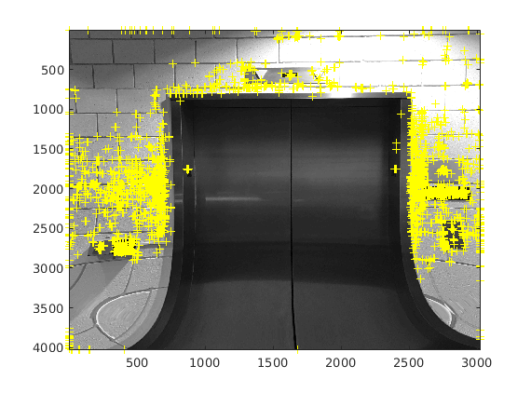

Slide 19
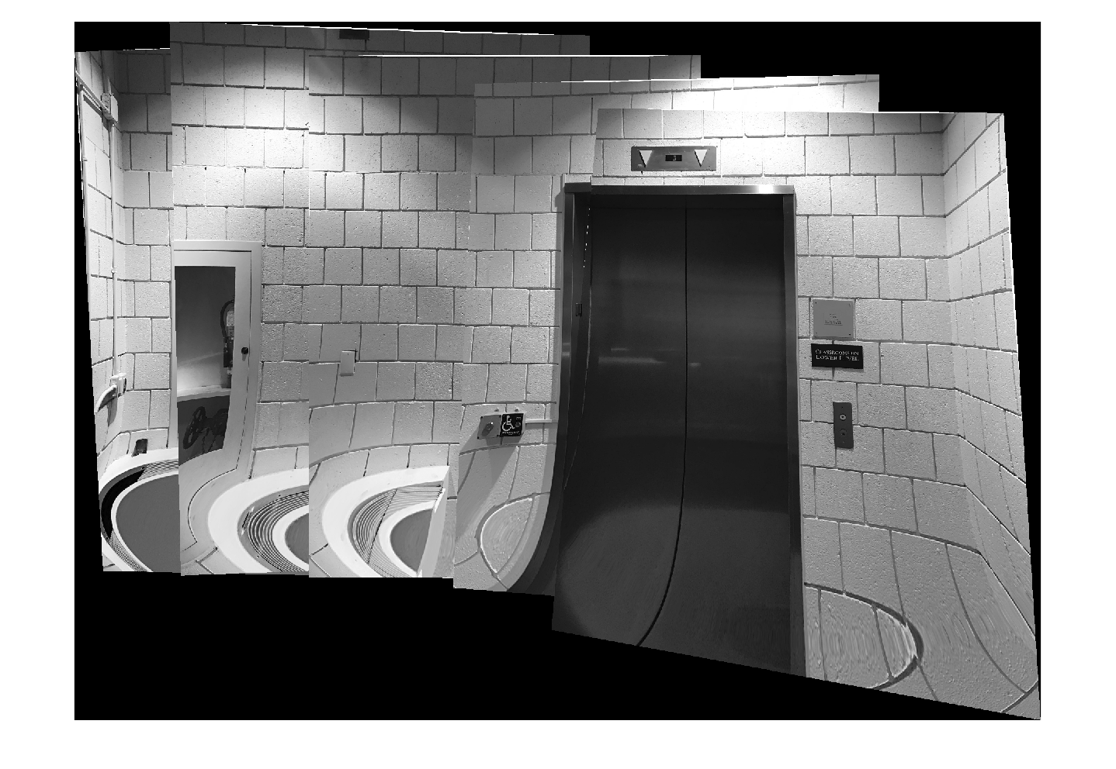
Panaroma-cinder

Slide 20
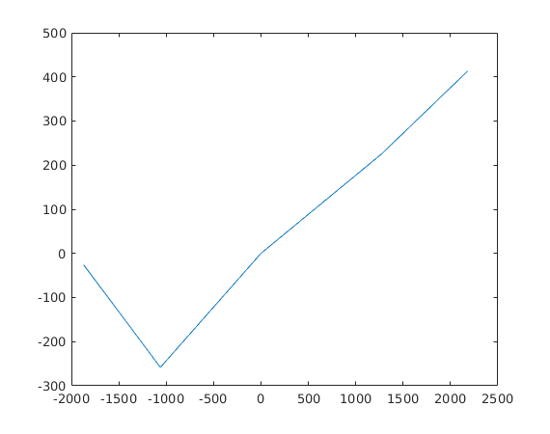
Camera position

Slide 21
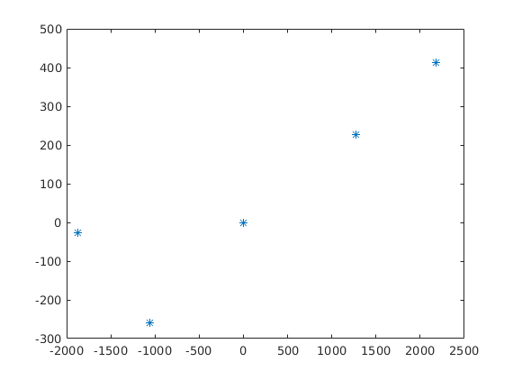

Slide 22
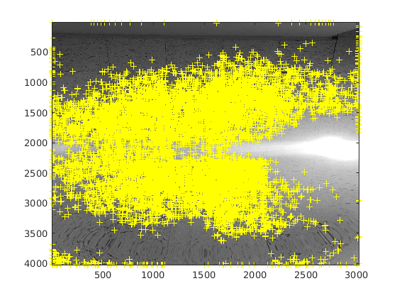
Harris corner

Slide 23
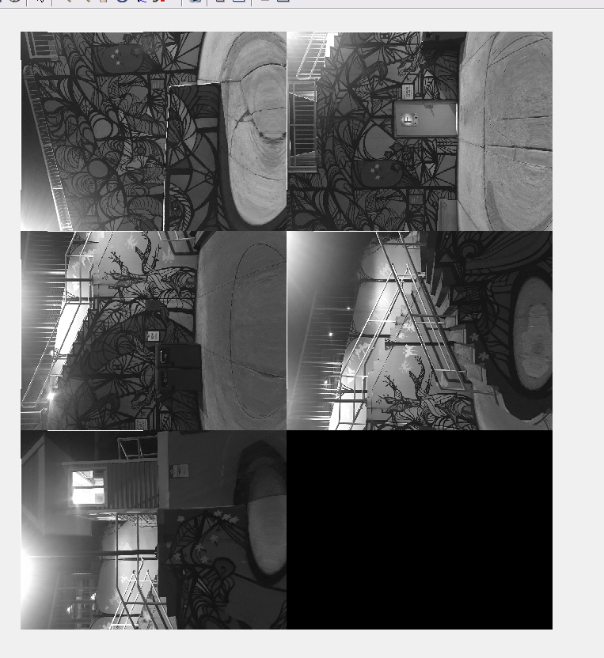
Graffiti Artwork for Panaroma

Slide 24
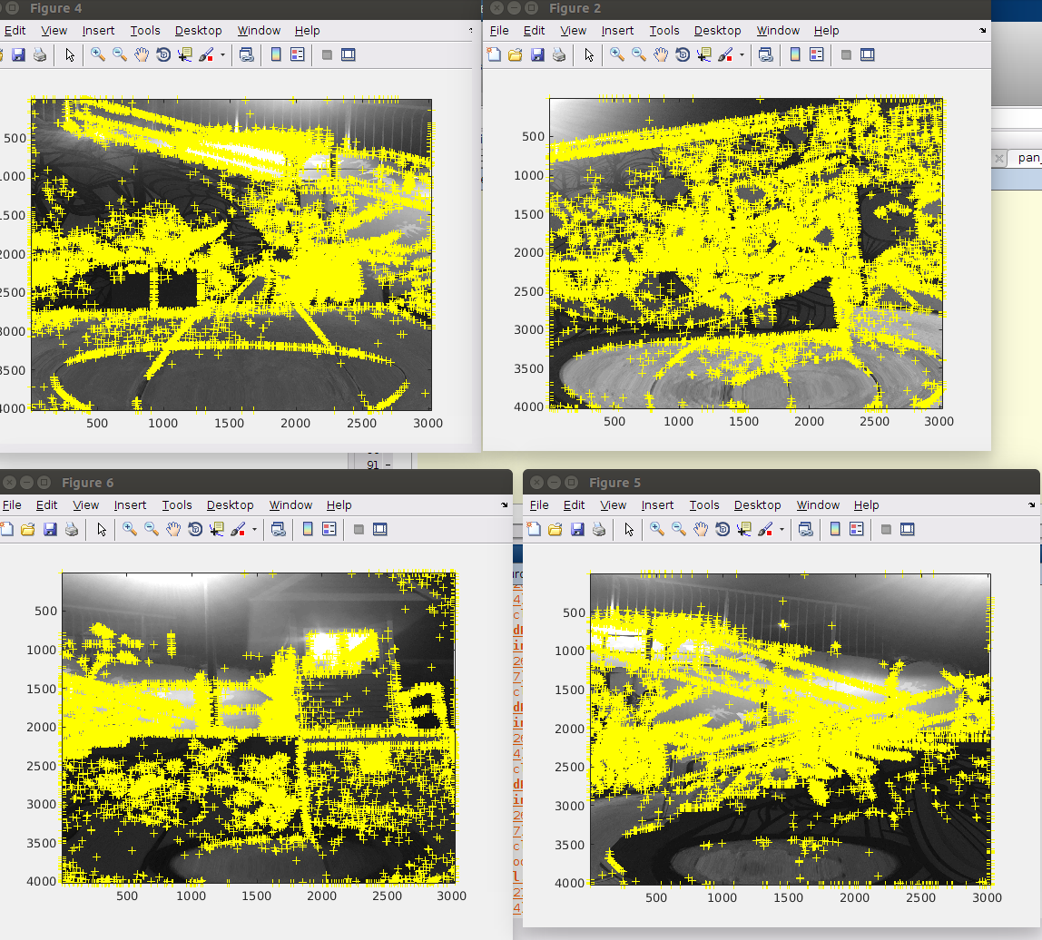
Harris corners

Slide 25
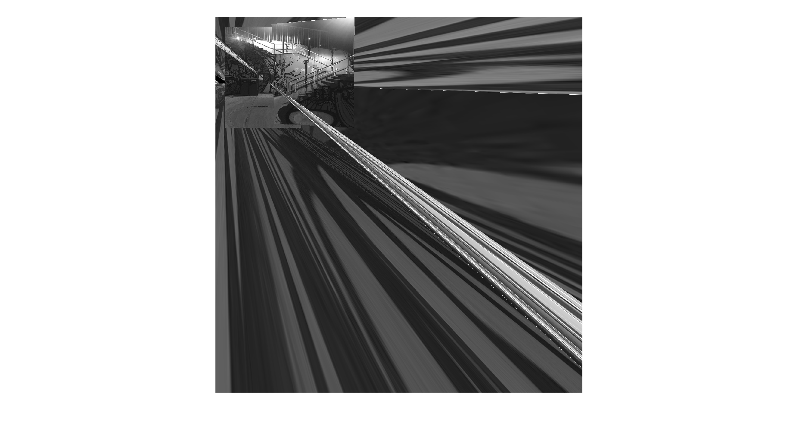
Panaroma bad

Slide 26
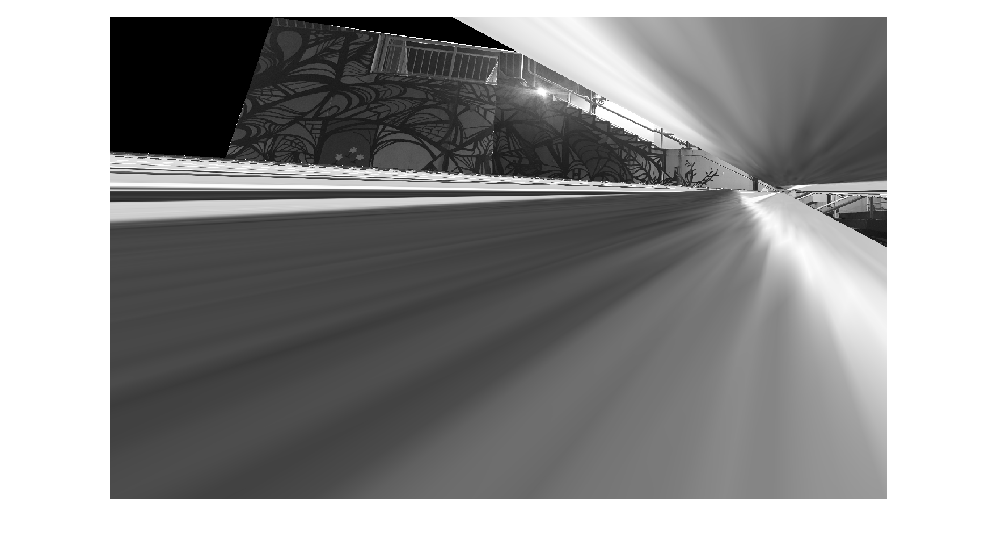
Panaroma good/better

Slide 27
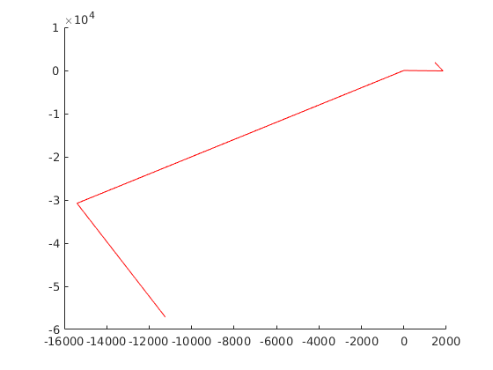
Camera position

Slide 28
Here, we have taken multiple set of images to make sure, we can get optimum results. Since the overlap is only 15 percent for the Graffiti artwork, the image detection algorithm we have used is harris detector. In comparison to others, such as Freak, fast and Surf algorithms, it does not fetch good results. Harris detector is especially used when we have a good enough overlap, and for faster execution times. As the number of images increases, the overlap percentage decreases, in our case 15 percent, and we need to use a faster algorithm in order to process the images and generate the output.

Slide 29
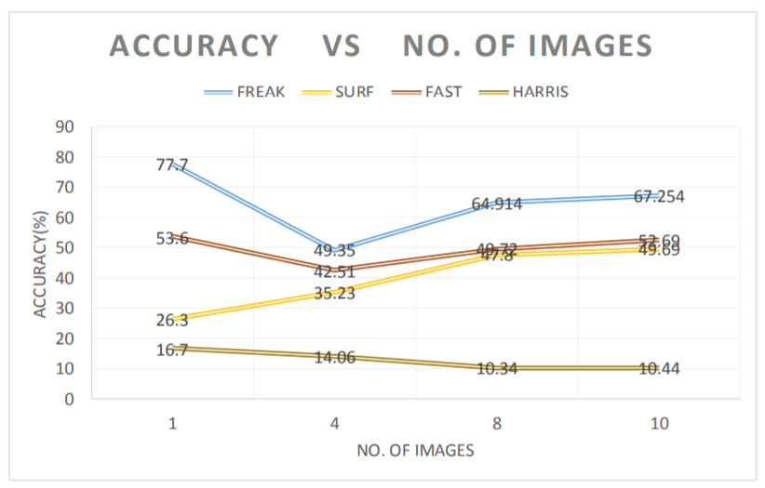

Slide 30
Thank you

